Slide 1
Can Animals do Maths?

Slide 2
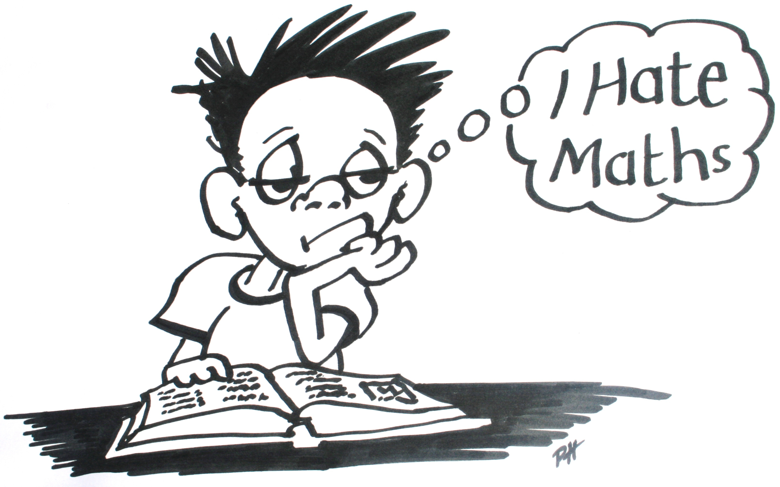
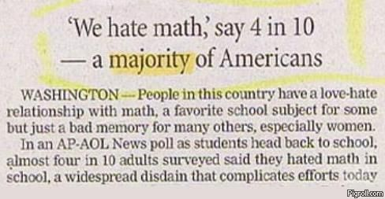

Slide 3
Notes:
Researchers in Kenya's Amboseli National Park used a camouflaged loud speaker to play the same phrase in different voices and languages.
They found the elephants were more frightened and moved away from the sound of adult males, who are more likely to be hunters, rather than women or children.
Elephants reacted when they heard the language of the Masai cattle rearing tribe, who they compete with for land, food and water,
but remained still for the Kamba tribe - crop farmers they don't come into conflict with

Slide 4
Animals are intelligent !
… but can they do maths?
Notes:
Number represents one of the abstract properties of items or events in the environment
"five" might be our verbal label to describe a group of large oranges, a line of small pebbles, a series of whistles, or how many times we knock on a door.
Only a few studies have shown that animals can learn symbols, similar to our digits, to represent the number of things, but they do this only after prolonged training.

Slide 5
http://news.discovery.com/animals/whales-dolphins/dolphins-math-geniuses-120717.htm
Notes:
Dolphins use sonar to hunt and locate fish, but use bubbles to ‘herd’ fish close together.
Human sonar systems are confused by bubbles as they scatter the sound waves in a nonlinear fashion that generate clutter in the sonar image that cannot be distinguished from the target.
So, the conclusion is that dolphins are solving these non-linear equations to hunt.

Slide 6
‘Flying Squirrels’
Do they use mathematics to
solve the complicated
equations of motion to allow
them to glide to their target?

Slide 7
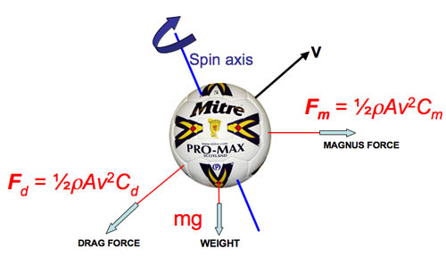
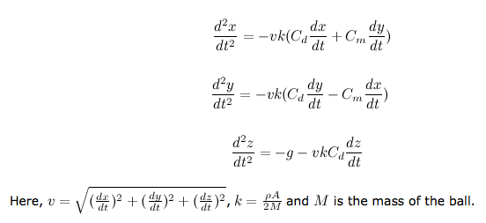
Bend it Like Carlos!
http://physics.wooster.edu/JrIS/Files/Ahmad_Web_Article.PDF
http://www.abc.net.au/tv/sleekgeeks/downloads/superhuman_research_extra_Beckahm.pdf
Notes:
Want to differentiate between doing maths i.e. solving problems in a mathematical sense rather than using skill/instinct/evolution to solve the same problems.

Slide 8
What does doing mathematics mean?
numerical reasoning
Ability to recognise quantities of objects
quantitative reasoning
Counting and understanding numbers
linguistic reasoning
symbolic reasoning
spatial reasoning
logical reasoning
diagrammatic reasoning
reasoning about causality
the ability to handle abstractions
Notes:
1. Number sense. This includes, for instance, the ability to recognize the difference between one object, a collection of two objects, and a collection of three objects, and to recognize that a collection of three objects has more members than a collection of two. Number sense is not something we learn. Child psychologists have demonstrated conclusively that we are all born with number sense.
2. Numerical ability. This involves counting and understanding numbers as abstract entities. Early methods of counting, by making notches in sticks or bones, go back at least 30,000 years. The Sumerians are the first people we know of who used abstract numbers: Between 8000 and 3000 B.C. they inscribed symbols for numbers on clay tablets.
3. Spatial-reasoning ability. This includes the ability to recognize shapes and to judge distances, both of which have obvious survival value for many animals.
4. A sense of cause and effect. Much of mathematics depends on "if this, then that" reasoning, an abstract form of thinking about causes and their effects.
5. The ability to construct and follow a causal chain of facts or events. A mathematical proof is a highly abstract version of a causal chain of facts.
6. Algorithmic ability. This is an abstract version of the fifth ability on this list.
7. The ability to handle abstraction. Humans developed the capacity to think about abstract entities along with our acquisition of language, between 75,000 and 200,000 years ago.
8. Logical-reasoning ability. The ability to construct and follow a step-by-step logical argument is another abstract version of item 5.
9. Relational-reasoning ability. This involves recognizing how things (and people) are related to each other, and being able to reason about those relationships. Much of mathematics deals with relationships among abstract objects.

Slide 9
Chimpanzees share 98.77% of their DNA with us.
So it seems like a good place to start looking for mathematical ability.

Slide 10
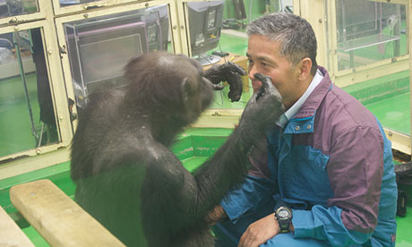
Primate Research Institute, Kyoto University
Prof Matsuzawa has been working in the field of primate memory for over 30 years.
Ai (36 years old) and Ayumu (her 13 year old son) were taught to recognise numbers 1-9 and put them in the correct order.
Professor Tetsuro Matsuzawa plays with chimpanzee Ai at the Primate Research Institute of Kyoto University. Photograph: Justin McCurry
Notes:
Prof Matsuzawa in Kyoto University’s Primate Research Institute.
Ai (36 years old) and Ayumu (13 year old son)

Slide 11
First numbers 1-9 were shown and then replaced with white squares.
Some numbers were even left out so they had to remember order.
https://www.youtube.com/watch?v=r5nTVF3uits

Slide 12
https://www.youtube.com/watch?v=qyJomdyjyvM

Slide 13
….. yeah, but can they count?
https://www.youtube.com/watch?v=VCy7M6ueSpE

Slide 14
Let’s try other species
https://www.youtube.com/watch?v=dFrlfFnkiug

Slide 15
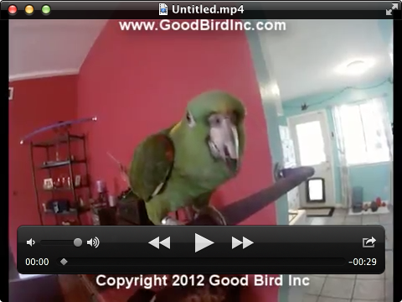
Ok, I was only joking there !!!

Slide 16
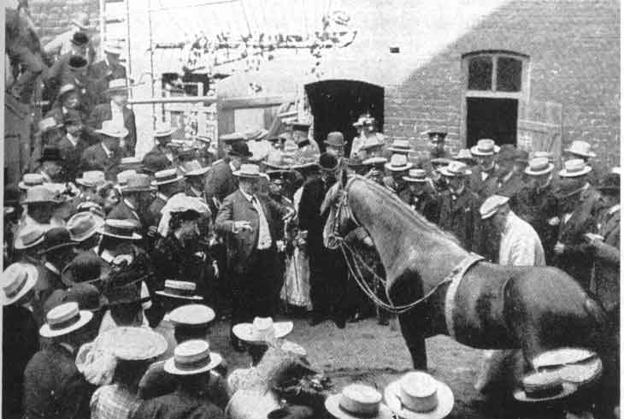
The ‘Clever Hans’ trick.
Clever Hans was an Orlov Trotter horse that was claimed to be able to perform arithmetic and other intellectual tasks.
After a formal investigation in 1907, psychologist Oskar Pfungst demonstrated that the horse was not actually performing these mental tasks, but was watching the reaction of the human observers.
http://en.wikipedia.org/wiki/Clever_hans
Notes:
Hans was said to have been taught to add, subtract, multiply, divide, work with fractions, tell time, keep track of the calendar, differentiate musical tones, and read, spell, and understand German. Von Osten would ask Hans, "If the eighth day of the month comes on a Tuesday, what is the date of the following Friday?” Hans would answer by tapping his hoof.

Slide 17
https://www.youtube.com/watch?v=cQwqgj46OtI

Slide 18
But parrots can be trained to count
Alex, the African Grey parrot has
been trained to vocalise words for different objects, colours and
shapes and can respond to a
“How Many?” question.
http://www.pigeon.psy.tufts.edu/avc/emmerton/
Notes:
An African Grey parrot has learned to "speak" the correct number (Pepperberg, 1987).
Pigeons have been trained to emit specific numbers of pecks when shown one of several digit-like symbols (Xia, Siemann & Delius, 2000).

Slide 19
But most species have an in-built mathematical ability
…ants, bees, parrots, rats, pigeons, fish, lions, birds, dogs, cats, dolphins, bears, raccoons, elephants, sea-lions, salamanders …

Slide 20
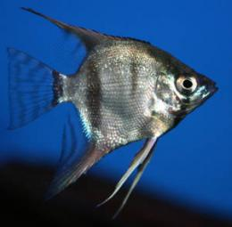
Fish
Christian Agrillo [experimental psychologist ] of the University of Padova in Italy,
conducted a series of experiments to see whether a lone mosquitofish would preferentially join a shoal of between two and four others. Females preferred to join shoals that were larger by just one fish significantly more often; consistently preferring shoals of four fish rather than three fish, and consistently preferring shoals of three fish over those containing just two.
This means the fish were clearly able to count up to four and demonstrates that fish have a rudimentary mathematical ability to visually count how many items are present if the number is small.
A second series of experiments revealed the fish’s ability to process larger numbers. The fish were not able to directly count over four, but they were able to distinguish between larger numbers if they differed by a ratio of 2:1. For example, the fish could distinguish between a shoal of 16, compared to a shoal of eight others. But they could not tell the difference between a shoal of 12 compared to a shoal of eight, a ratio of 3:2. This demonstrates that fish are able to visually estimate larger numbers - but not very accurately.
Although it doesn't sound much, it is actually on a par with the numerical abilities of monkeys and human infants between six and 12 months old, who are both able to visually count small numbers and less accurately estimate larger ones.
http://phys.org/news/2011-01-angelfish-math.html
http://www.neatorama.com/2008/02/27/fish-can-count/#!EkFzG
Notes:
not all ratios were as easy for the fish to recognize, however. For instance, the fish differentiated between ratios of 1:2 (8 versus 16) or 2:3 (8 versus 12) with ease, but they struggled when the ratio became 3:4 (9 versus 12). In other words, when the amounts on the doors were closer in number, the fish failed to tell them apart.
But their failure isn't shocking. It turns out that humans also find ratios closer in number more difficult to differentiate.
Imagine walking into a room with two piles of red balls. If you were told one pile had 50 balls and the other pile had 100, then you could probably identify which pile was which with ease. But what if one pile had 50 balls and the other pile had 60? It might be more difficult to see the difference.

Slide 21
Lions…
Wild lions use an innate numbering system to handle other approaching lions.
If they hear the roar of one individual they will send two or three females to investigate the stranger.
But if there are two approaching lions they keep their number advantage by sending a welcoming committee of four.
Rats…
Rats have been trained to press a lever a certain number of times before pressing a second lever for a reward (Davis & Bradford, 1986).

Slide 22
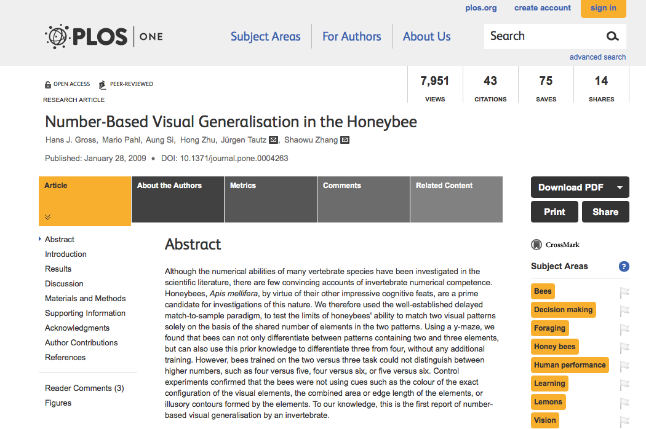

Slide 23
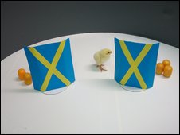
Baby Chicks…
Given the choice between a small group of familiar objects and a larger group of familiar objects, researchers noted that chicks tended to gravitate towards the larger group.
Researchers put the chicks in a glass cage and then hid yellow balls behind one of two screens. Sometimes they would then transfer some balls from one screen to another, in a process that the chick could see.
However, the chick couldn’t see how many balls were behind each screen, so the only way to keep track would be to keep track of how many balls moved from one side to another, and how many were initially on each side – in essence, to perform some basic mental arithmetic.
Surprisingly, the chicks were up to the challenge, and consistently went towards the larger group, even though the two groups were hidden from view.
http://www.mathgoespop.com/2009/05/baby-animals-just-want-to-do-math.html

Slide 24
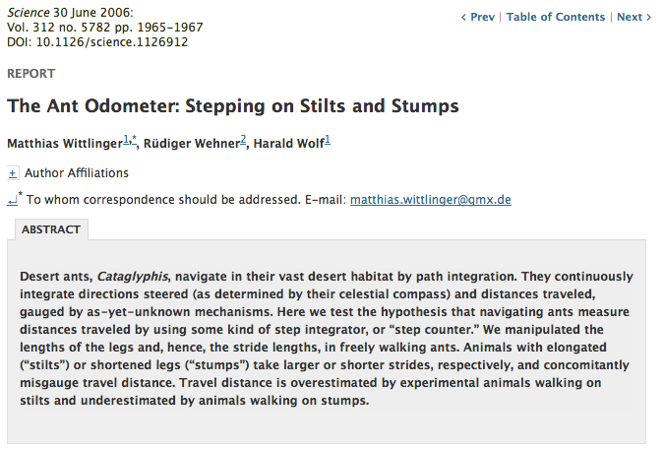
Ants…

Slide 25
Pigeons can discriminate against different amounts of number-like objects, order pairs, and learn abstract mathematical rules.
Aside from humans, only rhesus monkeys have exhibited equivalent skills.
http://news.discovery.com/animals/zoo-animals/pigeons-math-animals-111222.htm
Notes:
Scarf, a postdoctoral researcher in the Department of Psychology at the University of Otago, began the study by first teaching pigeons how to order the numbers 1, 2 and 3.
To do this, they presented the pigeons with three images containing one, two, or three objects. All three images appeared at once on a touch screen and the pigeons pecked the screen to make a response. If they correctly accomplished the task -- pecking the images in ascending order -- they received a wheat snack.
Next, the researchers upped the ante, to see whether or not pigeons had just learned to order 1, 2, and 3, or if they'd learned a more abstract rule. Scarf and his team presented the pigeons with pairs of images containing 1, 2, 3, 4, 5, 6, 7, 8, or 9 objects. The pigeons again had to pair the items in ascending order. For example, if a pigeon saw 8 and 5, it had to peck the objects representing 5 first.

Slide 26
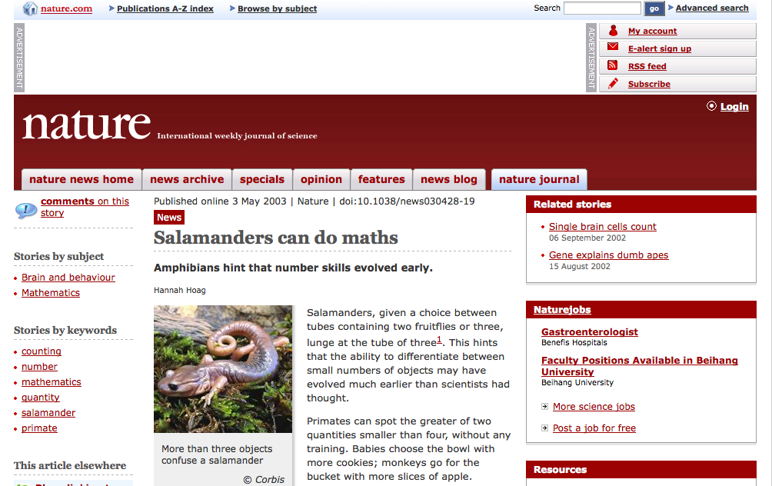
Math ability is being discovered in more and more species
doi:10.1007/s10071-003-0167-x
Notes:
Salamanders, given a choice between tubes containing two fruitflies or three, lunge at the tube of three. doi:10.1007/s10071-003-0167-x (2003).
The addition of salamanders to the list of animals with natural mathematical abilities hints that some notion of number evolved at least 28 million years ago
http://www.nature.com/news/1998/030428/full/news030428-19.html

Slide 27
Even we are all born with some innate mathematical ability
Babies choose the bowl with more cookies.
At 6 months we can perform addition and subtraction!

Slide 28
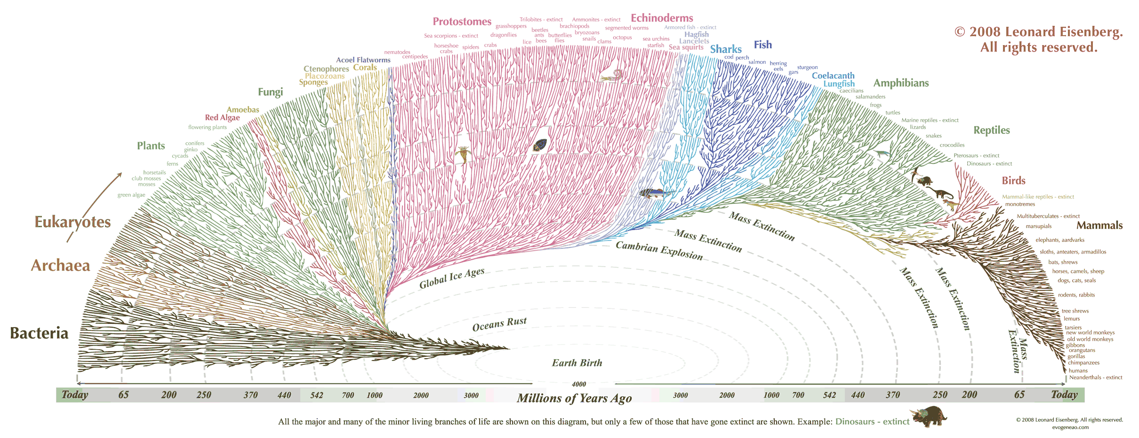
Numeracy Skills evolved some 28M years ago

Slide 29
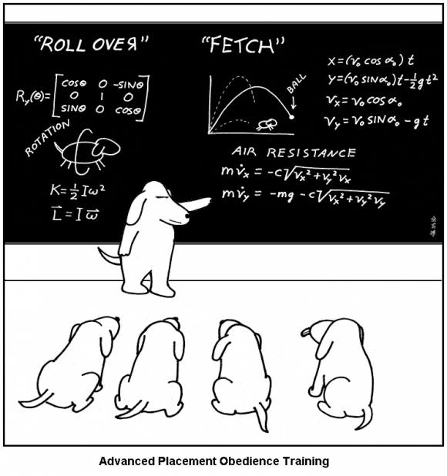
Calculus

Slide 30
Introducing Prof. Tim Pennings and Elvis
"I would throw a ball into the water," Pennings says. "I noticed he'd run along the beach and then jump into the water and swim at an angle toward the ball."
Pennings wondered if Elvis was instinctively taking the fastest possible route to the ball. First, he measured how fast Elvis runs and swims. Then, he threw a tennis ball into the water and let the little Welsh corgi go.
"I ran after Elvis with a screwdriver," says Pennings, who works at Hope College in Holland, Michigan. "Where he turned toward the water, I drove a screwdriver into the sand. While he was swimming to the ball, I ran and grabbed a tape measure and beat him to the ball."
https://student.societyforscience.org/article/its-math-world-animals

Slide 31
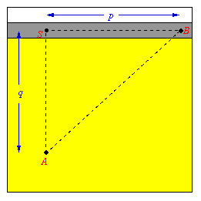
Common Calculus problem…
Suppose you are in the middle of a desert ( point A ) and you want to get to the town ( point B ) as fast as possible. Of course you can go straight from A to B, but you cannot move too fast in the desert. Going to the road first ( point S ) and hitching a ride there might be a better choice. So here is the problem: How to choose point S so as to minimize the time T it takes to get from A to B?
Notes:
https://student.societyforscience.org/article/its-math-world-animals
http://colgate.imodules.com/s/801/scene_inside.aspx?sid=801&gid=1&pgid=1250

Slide 32
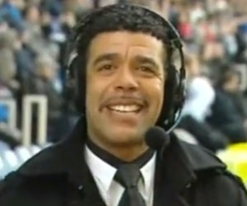
It’s Unbelievable Jeff!!

Slide 33
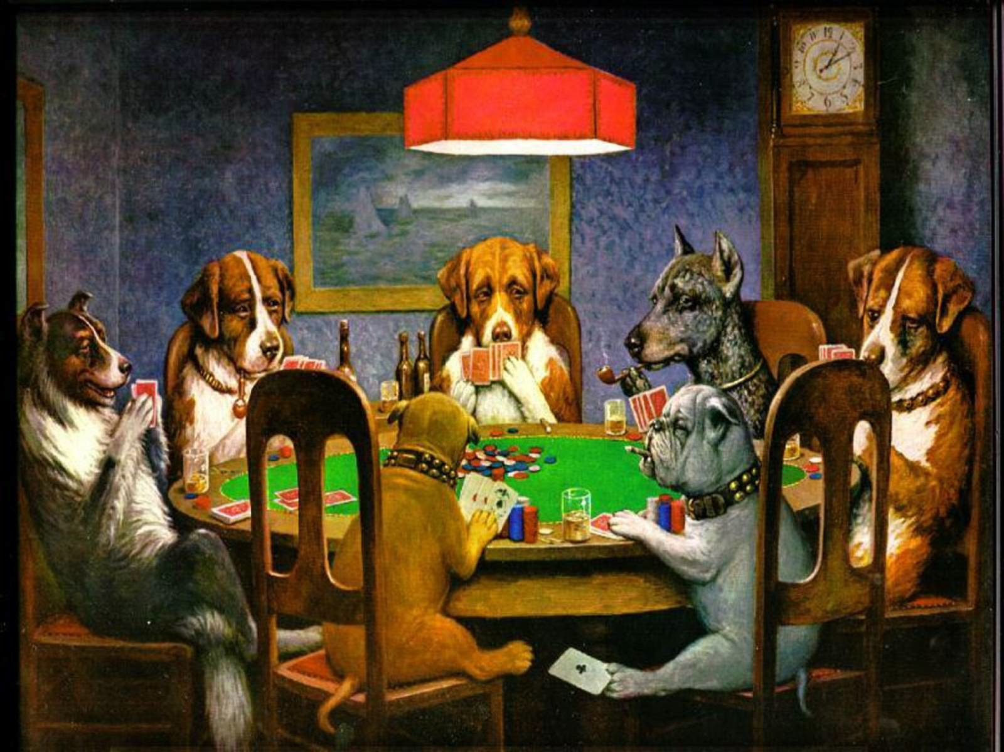
Game Theory

Slide 34
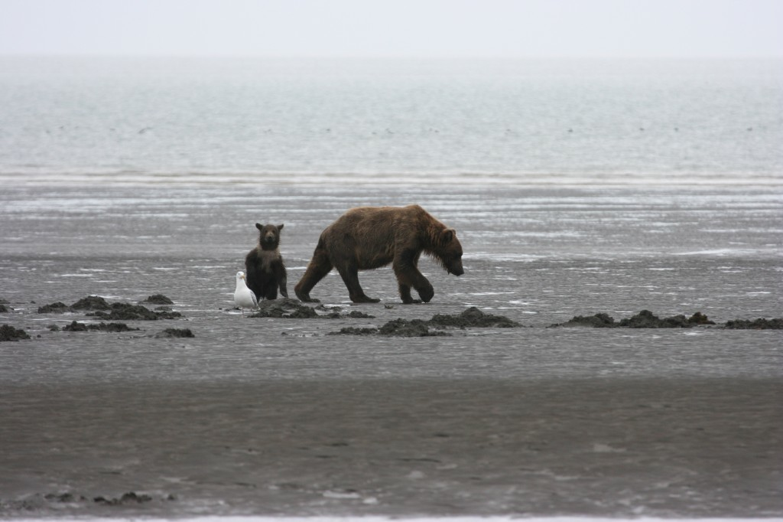
Bear .v. Seagull

Slide 35
Payoff:
Bear: dinner
Seagull: dinner
Cost:
Bear: Inconvenience
Seagull: Death

Slide 36
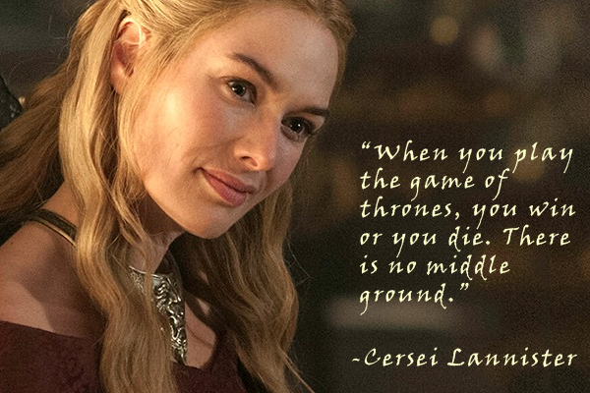

Slide 37
But not all games are so asymmetric
http://flickr.com/photos/23265522@N06/5638599313
Notes:
Male hartebeest strenuously defend their territories; they often stand on open, elevated areas to keep a lookout for intruders. Should a territorial male be challenged, a fight may develop. The hartebeest with its stout horns, short, strong neck and heavily muscled shoulders, is well-prepared for fighting. If the dispute over a territory is serious and both males are prepared to fight over it, severe injury may result.

Slide 38
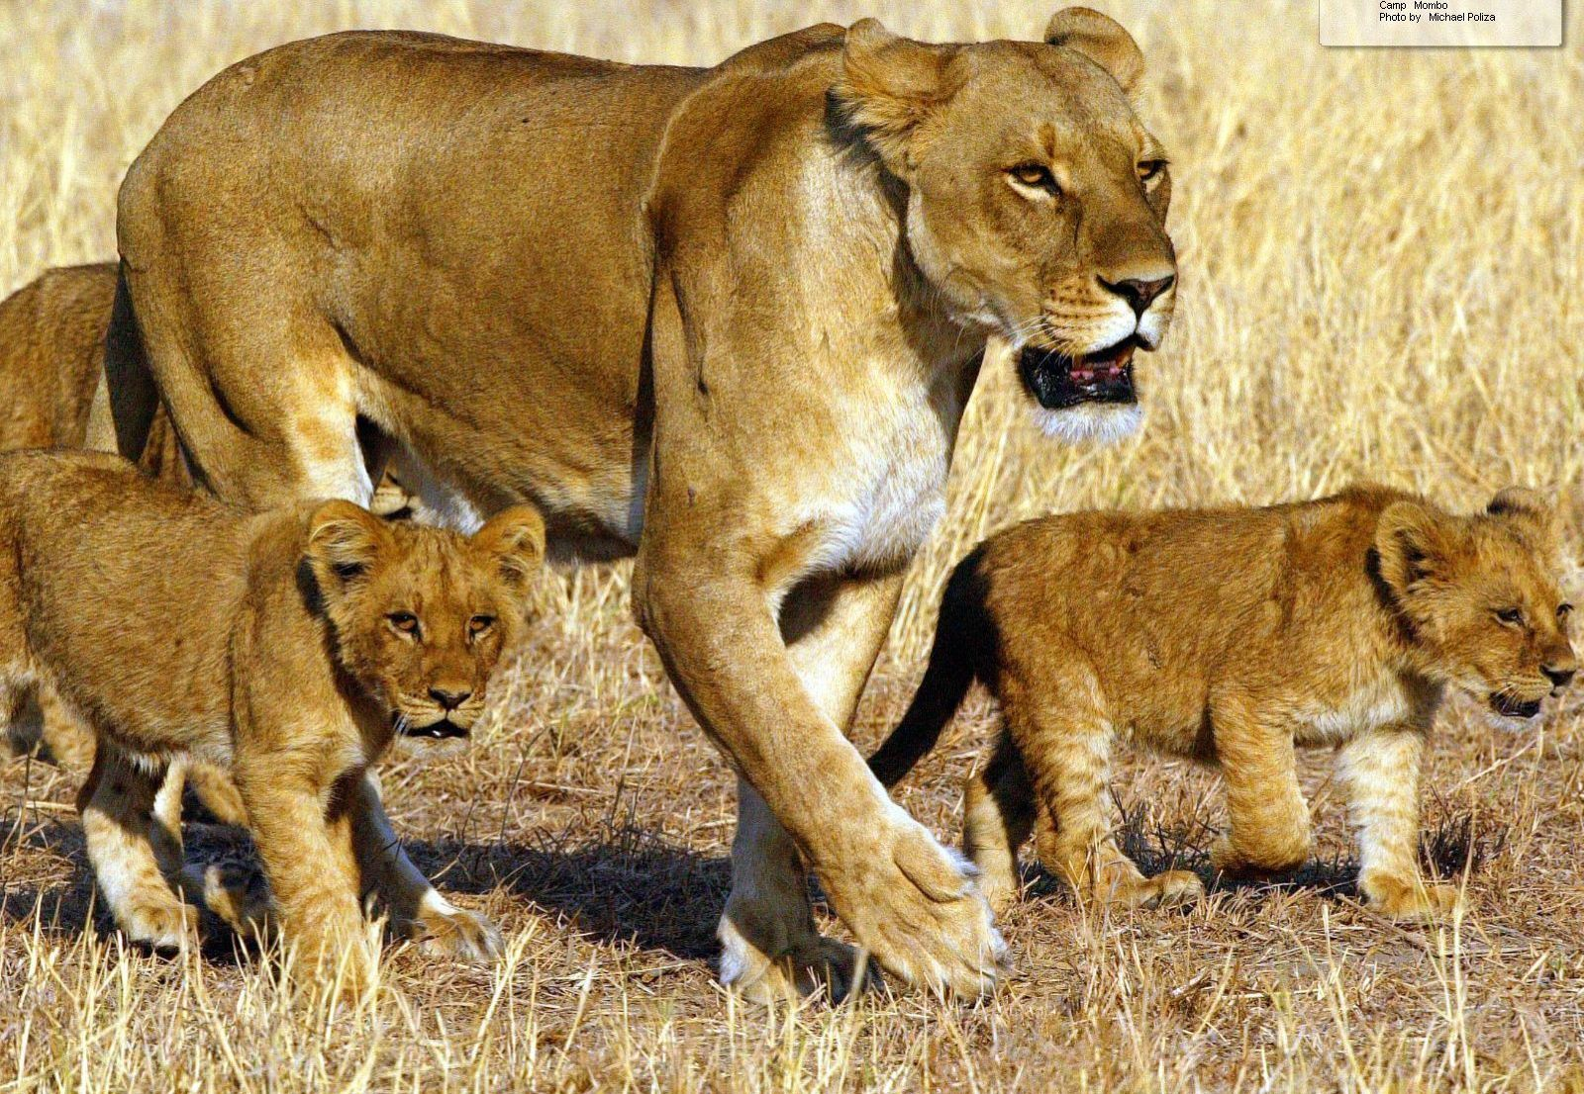
Wild Lions on African Savannah
If a single lion call is heard by a pride 2 or 3 females will go and investigate,
… but if 2 different calls are heard 4
lionesses will go to maintain the
advantage!
This suggests that not only can lions tell when they are "outnumbered" but that they can do this on the basis of signals from different sensory modalities, suggesting that numerosity is a multisensory concept.
McComb, K.; Packer, C.; Pusey, A. (1994), "Roaring and numerical assessment in contests between groups of female lions, Panthera leo", Animal Behavior 47: 379–387

Slide 39
Animals can [sometimes] do [some] mathematics...
… BUT…
https://www.youtube.com/watch?v=cAWaCtxH4ac

Slide 40
… and it was delicious …
Notes:
Only a few studies have shown that animals can learn symbols, similar to our digits, to represent the number of things, but they do this only after prolonged training.

Slide 41
… and it was delicious …

Slide 42
Next in Series.
“Is counting always as easy as 1 - 2 – 3?”
K Howie.
May 1st

